Slide 1
CASA0011: Agent-Based Modelling
Dr Sarah WISE
Dr Thomas OLÉRON-EVANS
s.wise@ucl.ac.uk
thomas.evans.11@ucl.ac.uk
Centre for Advanced
Spatial Analysis,
90 Tottenham Court Road

Slide 2
RECORDING

Slide 3
LECTURE 3 A systematic approach to planning and communicating ABMs

Slide 4
OBJECTIVES 1. Consider the sort of research questions that are suitable for ABM 2. Consider how ABMs can be constructed from a theoretical understanding of local processes. 3. Consider different perspectives on ABMs to provide a broad range of ideas for your own projects. 4. Learn how to use the ODD Protocol to plan and communicate ABMs

Slide 5
Course Objectives
You should...
1. understand the principles of agent-based modelling (ABM)
2. be able to describe the type and range of systems to which ABM can be profitably and appropriately applied
3. be able to conceptualise and model urban systems with complex dynamics
4. show evidence of being able to translate these understandings into the practical methodology of modelling

Slide 6
The ABM Course
Week 1: Introduction to ABMs
Week 2: Cellular Automata
Week 3: ABM Methodology
Week 4: Agent Behaviours
Week 5: ABMs as Research Tools
READING WEEK
Week 6: Testing ABMs
Week 7: Presenting Results
Week 8: Forecasting & Prediction
Week 9: Traffic Modelling
Week 10: Retail Markets & Gentrification

Slide 7
Coursework 1

Slide 8
Model Corner!

Slide 9
Presenting an ABM to the Class
Why was this model built?
What question is it looking to solve?
What are the different kinds of agents, and how do they interact with one another?
What is the environment, and how do agents interact with it?
What metrics do the authors use to measure the behaviour/performance of the system?
How do the authors attempt to validate their model?
What conclusions did the authors draw from the results of running the model?
Bonus: how might you expand upon the model, given the results the authors present here?

Slide 10
Roles of Quantitative Methods Defining a research question
To Calculate
To Summarise/Communicate
To Explore/Investigate
To Analyse
To Test
To Explain/Understand
To Predict/Forecast
To Improve/Optimise

Slide 11
Roles of Quantitative Methods Defining a research question
To Calculate
To Summarise/Communicate
To Explore/Investigate
To Analyse
To Test (in the sense of statistical hypothesis testing)
To Explain/Understand
To Predict/Forecast
To Improve/Optimise

Slide 12
Gilbert Paradigms Defining a research question
1. Facsimile Models
2. Middle Range Models
3. Abstract Models

Slide 13
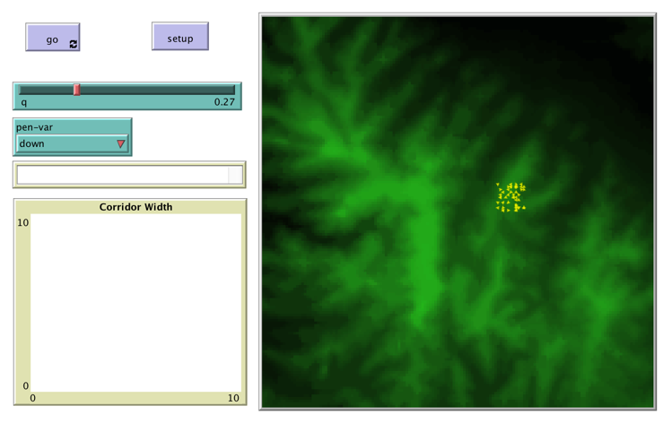
Gilbert Paradigms Defining a research question

Slide 14
Gilbert Paradigms Abstract Model – Research Question? Facsimile Model – Research Question?

Slide 15
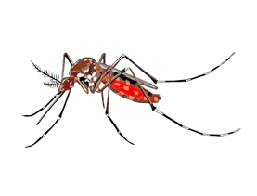
Gilbert Paradigms Middle Range Model – Barmak et al 2011
Time Step 1 day
Environment 20×20 blocks (each 100m×100m) representing city
Calibrated for Buenos Aires
Mosquitoes develop, feed (infect/ be infected), disperse (diffusion/Lévy flight), reproduce, die
Humans get bitten (infect/ be infected), recover,
mobility (Lévy flight/none)

Slide 16
Gilbert Paradigms Middle Range Model – Barmak et al 2011
Is the spread of dengue driven more by mosquito dispersal or human mobility?

Slide 17
Choosing Modelling Type (or justifying modelling type)

Slide 18
Systems Dynamics Models
Stocks
Flows
x
α
Notes:
18
18

Slide 19
Systems Dynamics Models
Children (0-15)
Adults (16-65)
Elderly (65-...)
How will these groups interact over time?
Notes:
19
19

Slide 20
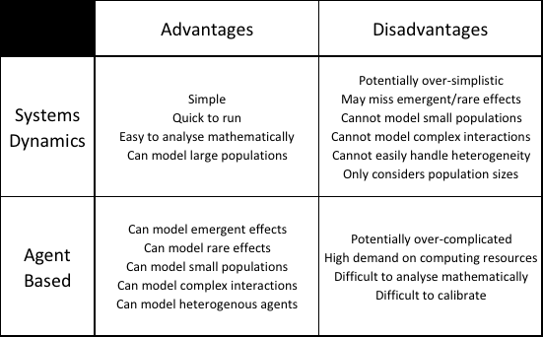
Systems Dynamics vs. Agent Based

Slide 21
Key Point
Should be able to justify why
your research question is suited to
the unique advantages of ABMs.

Slide 22
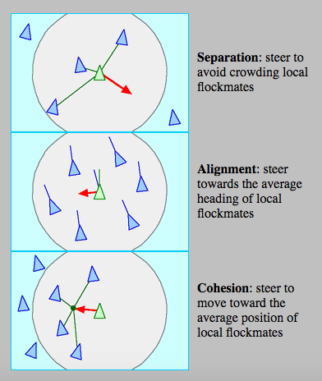
Building a Model from Theory Example 1 – Boids revisited
https://www.youtube.com/watch?v=V4f_1_r80RY
https://www.youtube.com/watch?v=zQhEGPrINJo
http://www.red3d.com/cwr/boids/

Slide 23
Building a Model from Theory Example 1 – Boids revisited
Key Pattern
Realistic Flocks
http://www.red3d.com/cwr/boids/

Slide 24
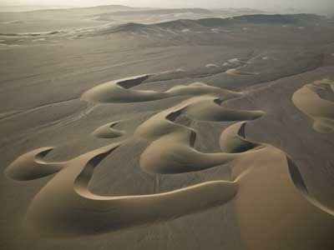

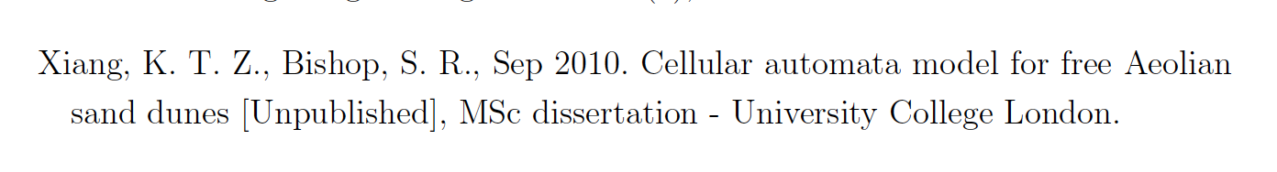
Building a Model from Theory Example 1I – Barchan Dunes
Namibia
Hellespontus

Slide 25
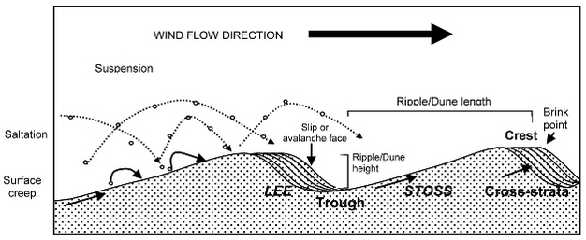
Building a Model from Theory Example 1I – Barchan Dunes
Sloss et al. (2012)
Traction
Suspension
Saltation/Reptation
Avalanche

Slide 26
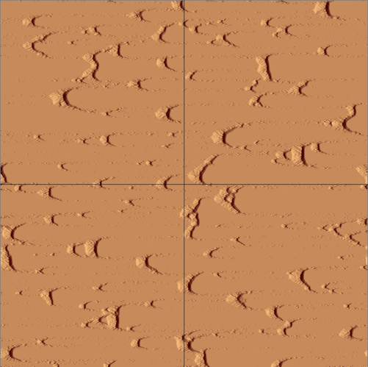
Building a Model from Theory Example 1I – Barchan Dunes
https://youtu.be/pL02a1l6edY?t=28s
http://www.ipgp.fr/~narteau/dunes.html

Slide 27
Building a Model from Theory Example 1I – Barchan Dunes
Key Pattern
Barchan Dunes
http://www.ipgp.fr/~narteau/dunes.html

Slide 28
Pattern-Oriented Modelling A one-slide guide…
1. No model can perfectly represent a real world system.
2. You should therefore begin the design process by
identifying key patterns that a model must reproduce
if it is to be valuable.
3. The more patterns that a model can reproduce; the
more confidence we can have that…
a) Conclusions drawn from the model are relevant
to the real world;
b) Processes operating in the model are also
operating in the real world.
See Railsback & Grimm (2019), Chapters 17-18, for further details…

Slide 29

Motivating the ODD Protocol Problem 1 – Defining an ABM
“... a computational method that enables a researcher to create, analyze, and experiment with models composed of agents that interact within an environment.” (Gilbert, 2008)
Spatially Explicit
vs.
Spatially Non-Explicit

Slide 30

Motivating the ODD Protocol Problem 1 – Defining an ABM
An agent should have:
Perception
Performance
(motion, communication, action)
Memory
Policy
(rules, strategies)
(Gilbert, 2008)

Slide 31
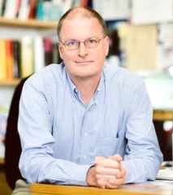
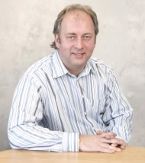
Motivating the ODD Protocol Problem 1 – Defining an ABM
An agent should have:
Autonomy
Social Ability
(Wooldridge & Jennings, 1995)
Reactivity
Pro-activeness (pursues goal)

Slide 32
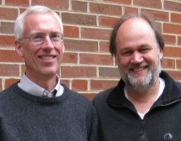
Motivating the ODD Protocol Problem 1 – Defining an ABM
“... models where individuals or agents are described as unique and autonomous entities that usually interact with each other or their environment locally.”
(Railsback & Grimm, 2011)

Slide 33
Motivating the ODD Protocol Problem 1 – Defining an ABM
Spatially Explicit
vs.
Spatially Non-Explicit

Slide 34
Motivating the ODD Protocol Problem 1 – Defining an ABM
Agents generally:
(Railsback & Grimm, 2011)
Possess heterogeneous features
Pursue their own objectives
Aim to “survive and reproduce”
Display “adaptive behaviour”

Slide 35
Motivating the ODD Protocol Problem 1 – Defining an ABM
“Agents interact with and influence each other, learn from their experiences, and adapt their behaviors so they are better suited to their environment.” (Macal, 2010)
“Agents are automata that take actions that depend on their current state and that of their neighbourhood.” (Cartwright, 2010)
“... multiple autonomous entities with either diverging information or diverging interests or both.” (Shoham & Leyton Brown, 2009)

Slide 36
Motivating the ODD Protocol Problem 1 – Defining an ABM
Agent-Based Modelling
Agent-Based Simulation
Agent-Based Simulation Modelling
Individual-Based Modelling
Multi-Agent Simulation
Multi-Agent-Based Simulation
Agent-Based Social Simulation
Individual-Based Configuration Modelling
Multi-Agent Systems
(Mostly Hare & Deadman, 2004)

Slide 37
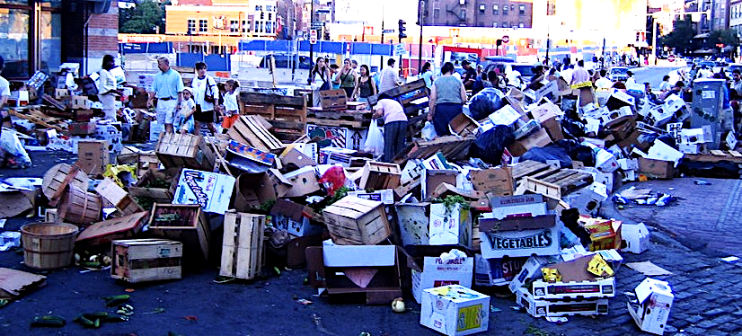
Basically…
A Total Mess
IMAGE: https://commons.wikimedia.org/wiki/File:Farmer%27s_market_mess.jpg

Slide 38
Motivating the ODD Protocol Problem 1 – Defining an ABM
Lack of common understanding of what an ABM is
Any attempt to organise the discipline
must cater for a huge variety of possible models
IMAGE: https://commons.wikimedia.org/wiki/File:Farmer%27s_market_mess.jpg

Slide 39
Hare & Deadman’s ABM Taxonomy “Modelling Requirements”
Modelling Space Spatially explicit / Spatially non-explicit
Modelling Decision Making Fixed behaviour --- Sophisticated rules/algorithms
Modelling Interaction Completely asocial / Group-based interaction / Social adaptation
Modelling Intrinsic Behavioural Adaptation None / Discrete choice of strategies / Strategic fine-tuning
Modelling Population-Level Adaptation Fixed population / Evolutionary dynamics
Modelling on Multiple Scales Single scale / Hierarchies of agents

Slide 40
Hare & Deadman’s ABM Taxonomy “Modelling Requirements”
Modelling Space Spatially explicit / Spatially non-explicit
Modelling Decision Making Fixed behaviour --- Sophisticated rules/algorithms
Modelling Interaction Completely asocial / Group-based interaction / Social adaptation
Modelling Intrinsic Behavioural Adaptation None / Discrete choice of strategies / Strategic fine-tuning
Modelling Population-Level Adaptation Fixed population / Evolutionary dynamics
Modelling on Multiple Scales Single scale / Hierarchies of agents

Slide 41
Motivating the ODD Protocol Problem 1I – Communication
Comprehensible
Comprehensive
Reproducible
Programmable
Comparable

Slide 42

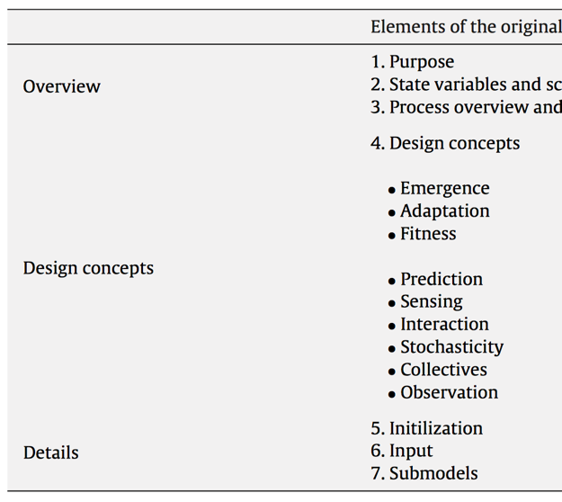
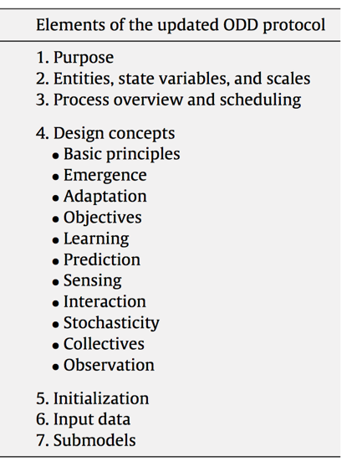
The ODD Protocol
Grimm et al. (2006)
(>1600 citations)
Grimm et al. (2010)
(>1300 citations)
Grimm et al. (2020)
(>50 citations)
and Patterns

Slide 43
The ODD Protocol
General
and Patterns
(Conceptual)
Specific

Slide 44
The ODD Protocol
Include all 7 elements…
… in order.
and Patterns

Slide 45
ODD: Overview
Purpose and Patterns Question/Problem/Hypothesis/Objectives Key patterns that should be reproduced by the model
Entities, State Variables & Scales What are the entities (agents, spatial units, etc.)? What variables are associated with them? What is the real world interpretation of these variables? What is the real world interpretation of model space/time?
Process Overview & Scheduling Skeleton of model events (‘move’, ‘grow’, ‘update energy levels’) Synchronous/random asynchronous/ordered asynchronous schedules?

Slide 46
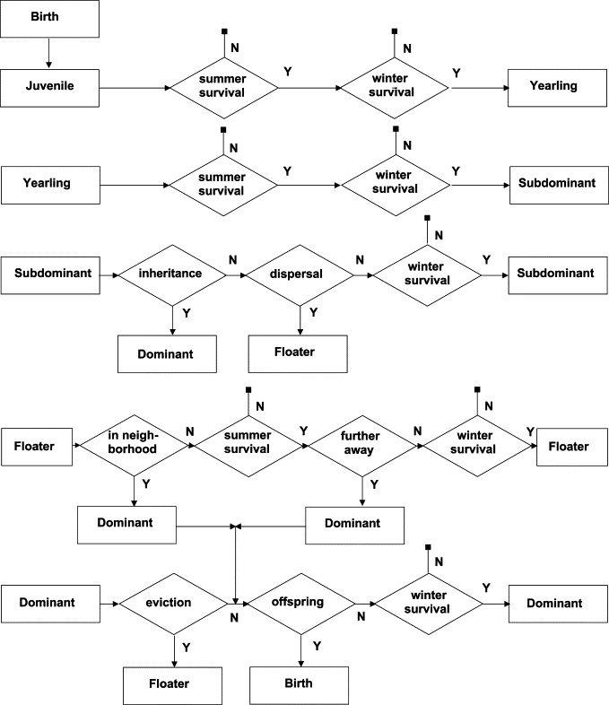
Process Overview & Scheduling
“Life history of the model marmots showing the transitions between different age and social classes, as well as the processes which cause these transitions.”
(from Grimm et al., 2003, after Dorndorf, 1999)

Slide 47
ODD: Design Concepts
Design Concepts

Slide 48
ODD: Design Concepts
Basic Principles
Emergence
Adaptation
Objectives
Learning
Prediction
Sensing
Interaction
Stochasticity
Collectives
Observation
GENERAL
CONCEPTS
AGENT
FOCUSSED
BOTH

Slide 49
ODD: Design Concepts General Concepts
Basic Principles Concepts/Theory underlying the model
Emergence What emergent features are expected/studied?
Stochasticity Does the model include randomness?
Observation What quantities are measured/recorded?

Slide 50
ODD: Design Concepts Agent Focussed
Adaptation How do individuals adapt their behaviour?
Objectives What are the objectives of individuals?
Learning How do individuals learn?
Prediction Do individuals make predictions?
Sensing How do individuals monitor their environment?
Interaction How do agents interact (directly and indirectly)?
Collectives Do the entities form groups? Explicit or emergent?

Slide 51
ODD: Details
Initialisation Start of model
Input Data While running Reproducibility Multiple runs External data sources/files?
Submodels Precise algorithms for each model process (‘move’, ‘grow’, ‘update energy levels’) Discussion of design, calibration, testing

Slide 52
Motivating the ODD Protocol Addressing Problems
Comprehensible
Comprehensive
Reproducible
Programmable
Comparable
Any attempt to organise the discipline must cater for a huge variety of possible models

Slide 53
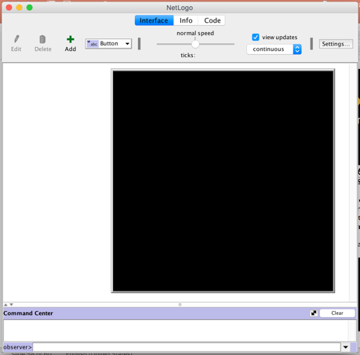
The ODD Protocol Integration with NetLogo

Slide 54
The ODD Protocol Key Texts
Grimm, et al. (2006). A standard protocol for describing individual-based and agent-based models. Ecological Modelling 198 (1-2), 115-126.
Grimm, et al. (2010). The ODD protocol: A review and first update. Ecological Modelling 221 (23), 2760-2768.
Grimm, et al. (2020). The ODD Protocol for Describing Agent-Based and Other Simulation Models: A Second Update to Improve Clarity, Replication, and Structural Realism. The Journal of Artificial Societies and Social Simulation 23 (2), 7.
Grimm, et al. (2020). S1: ODD Guidance and Checklists. The Journal of Artificial Societies and Social Simulation 23 (2) [Supplementary file S1 to Grimm et al. (2020), above]

Slide 55
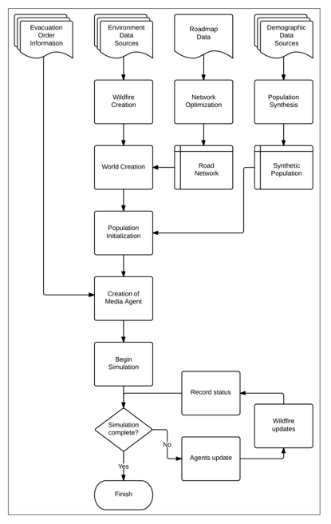
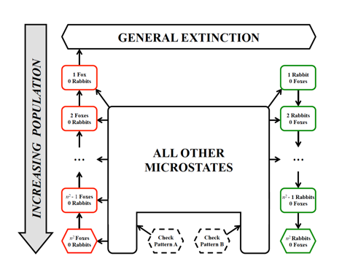
PhD Theses Available on Moodle

Slide 56
Bibliography ABM Lecture III – Page 1
Gilbert, N., 2008. Agent-Based Models. No. 153 in Quantitative Applications in the Social Sciences. SAGE Publications, Thousand Oaks, USA.
Wooldridge, M., Jennings, N. R., Jun 1995. Intelligent agents: theory and practice. The Knowledge Engineering Review 10 (2), 115-152.
Macal, C. M., Dec 2010. To agent-based simulation from system dynamics. In: Johansson, B., Jain, S., Montoya-Torres, J., Hugan, J., Yucesan, E. (Eds.), Proceedings of the 2010 Winter Simulation Conference. Institute of Electrical and Electronics Engineers, New York, USA, 371-382.
Cartwright, J. H. E., May 2010. Agent-based social simulation: A dynamical systems viewpoint. Cybernetics and Systems 41 (4), 281-286.
Shoham, Y., Leyton-Brown, K., 2009. Multiagent Systems: Algorithmic, Game-Theoretic, and Logical Foundations. Cambridge University Press, Cambridge, UK.
Hare, M., Deadman, P., Jan 2004. Further towards a taxonomy of agent-based simulation models in environmental management. Mathematics and Computers in Simulation 64 (1), 25-40.
Grimm, V., Berger, U., Bastiansen, F., Eliassen, S., Ginot, V., Giske, J., Goss-Custard, J., Grand, T., Heinz, S. K., Huse, G., Huth, A., Jepsen, J. U., Jorgensen,C., Mooij, W. M., Muuller, B., Pe'er, G., Piou, C., Railsback, S. F., Robbins, A. M., Robbins, M. M., Rossmanith, E., Ruger, N., Strand, E., Souissi, S., Stillman, R. A., Vabo, R., Visser, U., DeAngelis, D. L., Sep 2006. A standard protocol for describing individual-based and agent-based models. Ecological Modelling 198 (1-2), 115-126.
Grimm, V., Berger, U., DeAngelis, D. L., Polhill, G., Giske, J., Railsback, S. F., Nov 2010. The ODD protocol: A review and first update. Ecological Modelling 221 (23), 2760-2768.

Slide 57
Bibliography ABM Lecture III – Page 2
V. Grimm, N. Dorndorf, F. Frey-Roos, C. Wissel, T. Wyszomirski, W. Arnold, 2003, Modelling the role of social behavior in the persistence of the alpine marmot Marmota marmota, Oikos, 102, pp. 124-136
Billari, F. C., A. Prskawetz, B. Aparicio Diaz, and T. Fent. 2007. The “wedding-ring”: an agent-based marriage model based on social interactions. Demographic Research 17:59-82. Available on-line at: www.demographic-research.org/Volumes/Vol17/3/
D.H. Barmak, D.O. Dorso, M. Otero, H.G. Solari, 2011, Dengue epidemics and human mobility, Phys. Rev. E 84 (1).
Xiang, K. T. Z., Bishop, S. R., Sep 2010. Cellular automata model for free Aeolian sand dunes [Unpublished], MSc dissertation - University College London.
Sloss, C. R., Hesp, P. & Shepherd, M. (2012) Coastal Dunes: Aeolian Transport. Nature Education Knowledge 3(10):21
Railsback, S. F., Grimm, V., 2019. Agent-Based and Individual-Based Modeling: A Practical Introduction [2nd Ed.]. Princeton University Press, Princeton, USA.
Grimm, V., Railsback, S., Vincenot, C., Berger, U., Gallagher, C., DeAngelis, D., Edmonds, B., Ge, J., Giske, J., Groeneveld, J., Johnston, A., Milles, A., Nabe-Nielsen, J., Polhill, J., Radchuk, V., Rohwader, M., Stillman, R., Thiele, J., Ayllon, D., Apr 2020a. The ODD Protocol for Describing Agent-Based and Other Simulation Models: A Second Update to Improve Clarity, Replication, and Structural Realism. The Journal of Artificial Societies and Social Simulation 23 (2), 7.
Grimm, V., Railsback, S., Vincenot, C., Berger, U., Gallagher, C., DeAngelis, D., Edmonds, B., Ge, J., Giske, J., Groeneveld, J., Johnston, A., Milles, A., Nabe-Nielsen, J., Polhill, J., Radchuk, V., Rohwader, M., Stillman, R., Thiele, J., Ayllon, D., Apr 2020b. S1: ODD Guidance and Checklists. The Journal of Artificial Societies and Social Simulation 23 (2) [Supplementary file S1 to Grimm et al. (2020a), above]

Slide 58
OBJECTIVES 1. Consider the sort of research questions that are suitable for ABM 2. Consider how ABMs can be constructed from a theoretical understanding of local processes. 3. Consider different perspectives on ABMs to provide a broad range of ideas for your own projects. 4. Learn how to use the ODD Protocol to plan and communicate ABMs

Slide 59
CASA0011: Agent-Based Modelling
Dr Sarah WISE
Dr Thomas OLÉRON-EVANS
s.wise@ucl.ac.uk
thomas.evans.11@ucl.ac.uk
Moodle password: ABM18
Centre for Advanced
Spatial Analysis,
90 Tottenham Court Road

